Slide 1
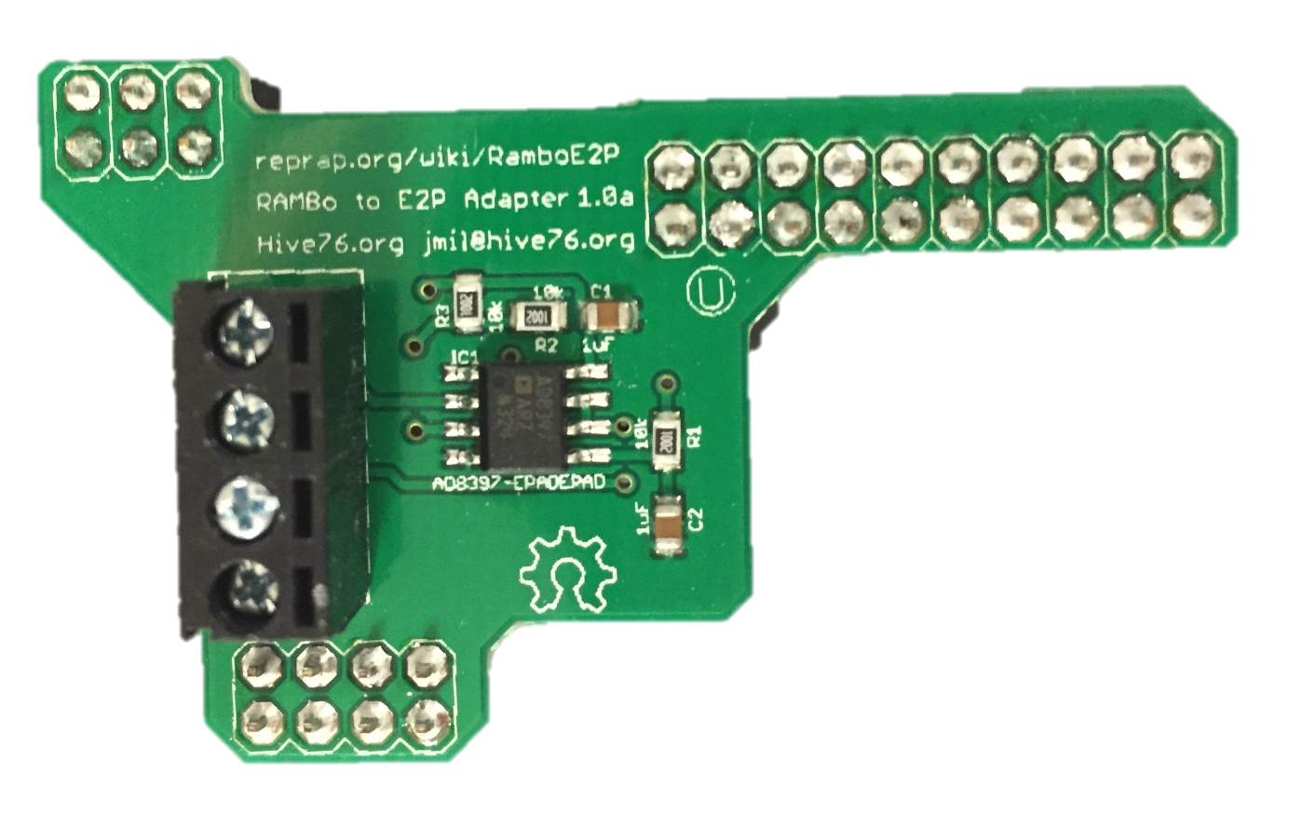
Z endstop
X endstop
Y endstop
USB Connection to PC
PWM-Voltage Transducer
Solenoid Valve
RAMBo v1.2
Optional heated bed
See zoomed in view of motor ext pins
+ - + - + -
Electropneumatic (E/P) transducer
RAMBo power supply: 12V DC; 30A
Important: RAMBo and ShopBot need common ground
ShopBot 48V built-in power supply

Slide 2
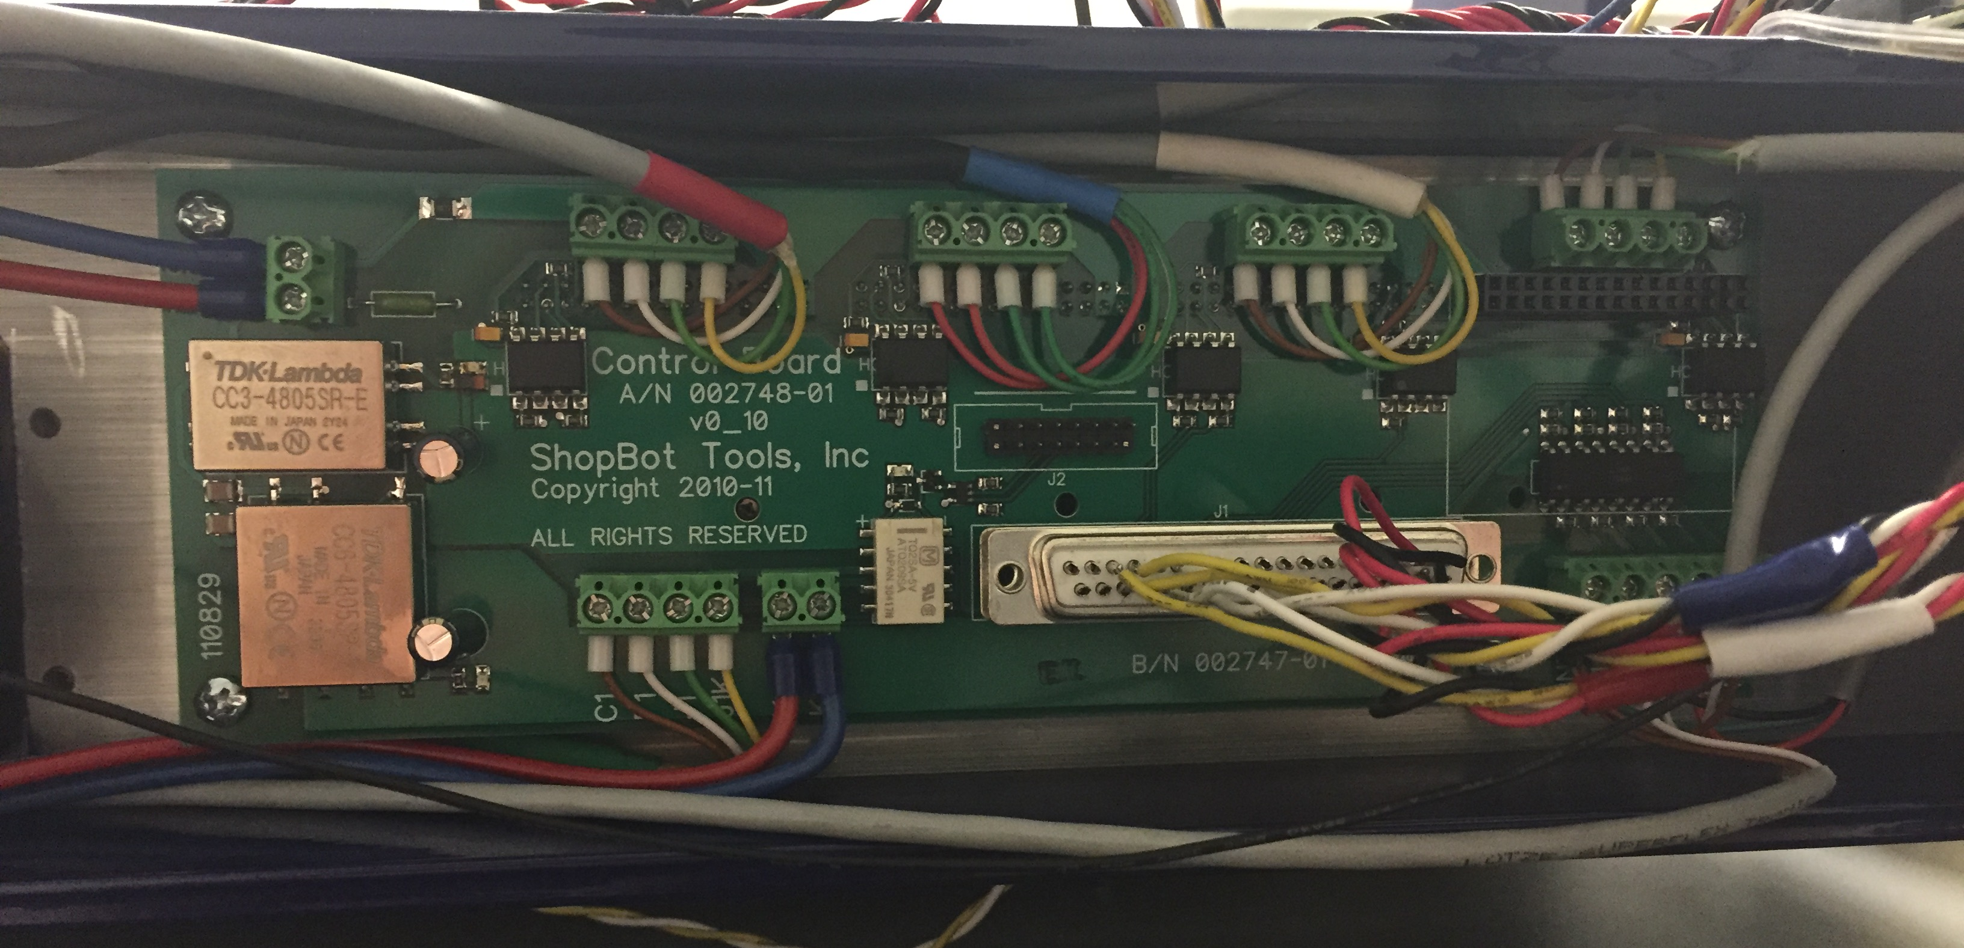

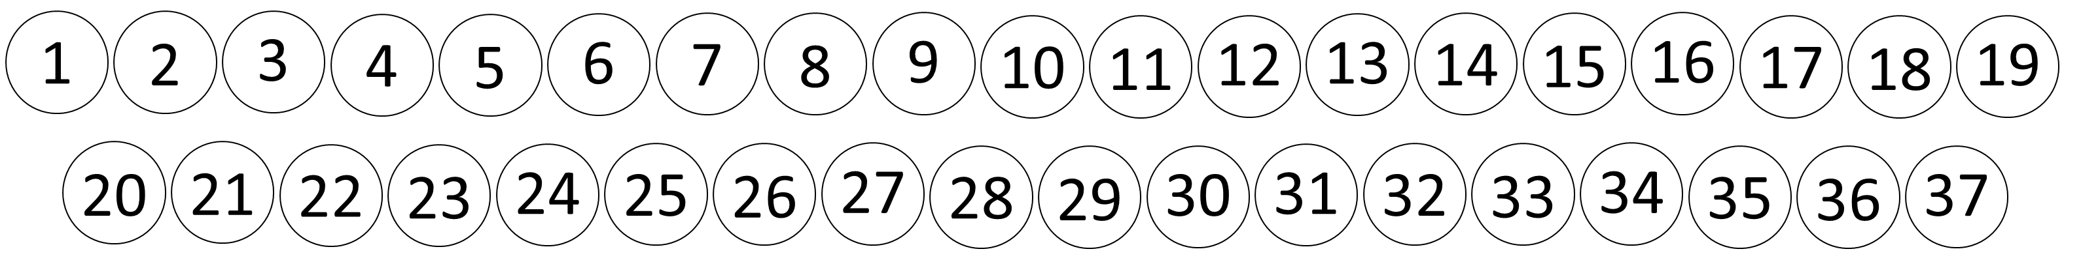
RAMBo connection to ShopBot stepper drivers
Remove ShopBot motherboard and install 37-pin connector:
37-pin connector
Connec
Connect RAMBo pins as follows:
Rambo Motor EXT Pins (in same orientation as wiring diagram)
Connect each motor ext pin on the RAMBo to the indicated pin on the 37-pin connector.
Note that the center row of motor ext pins is not used.
18
6
24
16
3
X motor
Y motor
Z motor
35
22
17
4
19
36
25
37-pin connector

